Slide 1
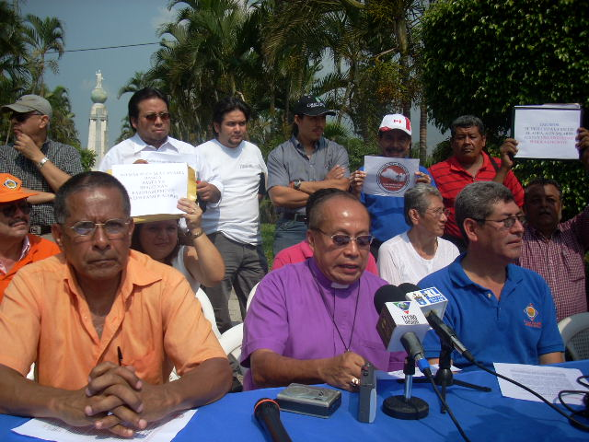
The Pastoral and Servant Work of the Salvadoran Lutheran Church

Slide 2
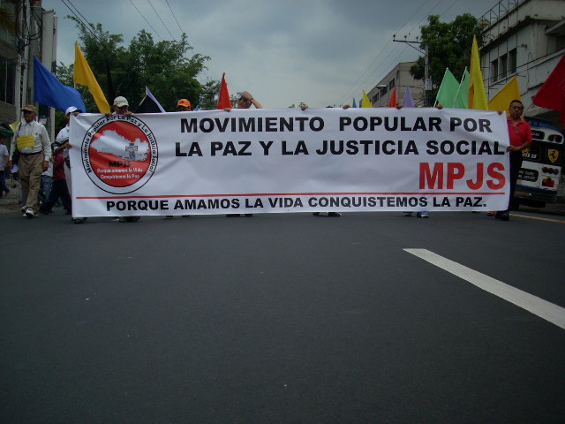
Our foundation
The pastoral ministry is inspired by the theology of life: prophetic ministry, based on the testimony of our Lord Jesus Christ.

Slide 3
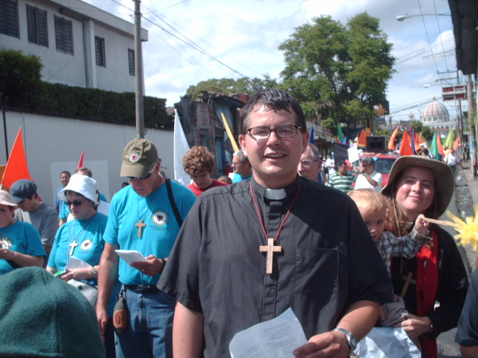
The love of God which extends to all creation is globalization of hope and solidarity.

Slide 4
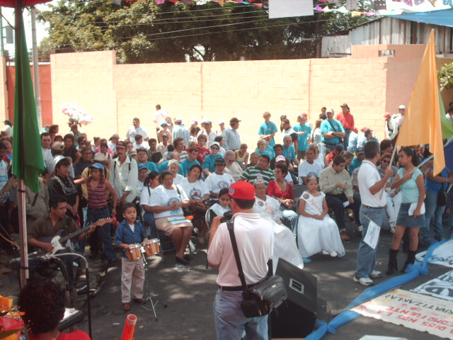
The church performs comprehensive prophetic and transformative pastoral work to respond to the signs of the times, promoting the defense of the lives of the poorest ones as an act of grace

Slide 5
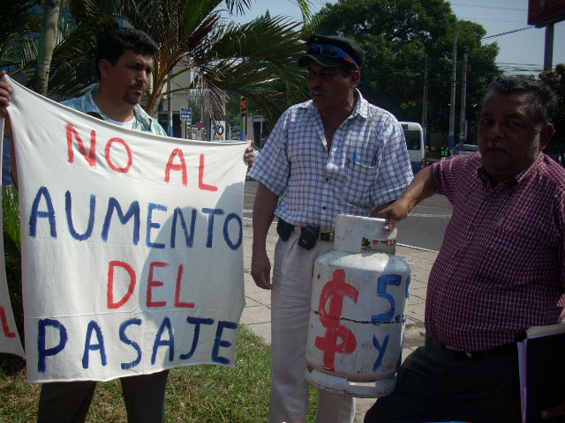
Comprehensive Focus on the Theology of Life
Prophetic process comes from congregational practice
Production of thougts, concepts, and theological focus that sustain our pastoral practice

Slide 6
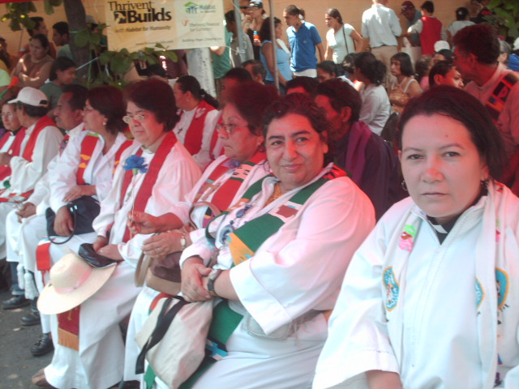
An ecumenical focus that ecourages cooperation between different churches and segments of society in service of those most in need.

Slide 7
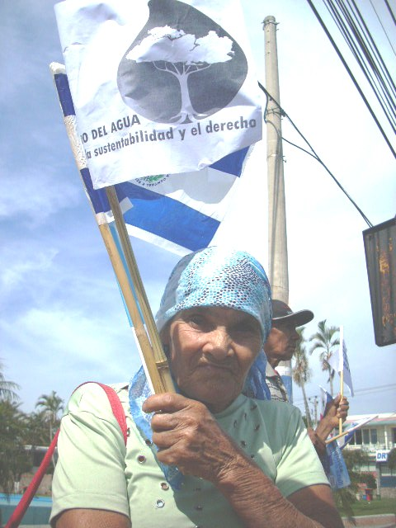

Slide 8
Salvadoran Lutheran Church Strategies
Accompaniment of the communities and sectors of society on topics such as risk management, HIV-AIDS, povert y and hunger.
Strengthening of the capacity of the church and related organizations to provide quality service.
Sustainability of the processes that will empower the base and encourage participation from community members across different sectors of society.

Slide 9
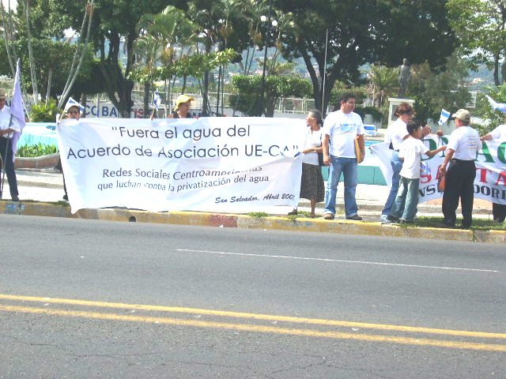

Slide 10
Public Advocacy Work
Weekly statements in the media
Accompany movements/demonstrations of the people and communities
Participate in networks committed to peace and justice

Slide 11
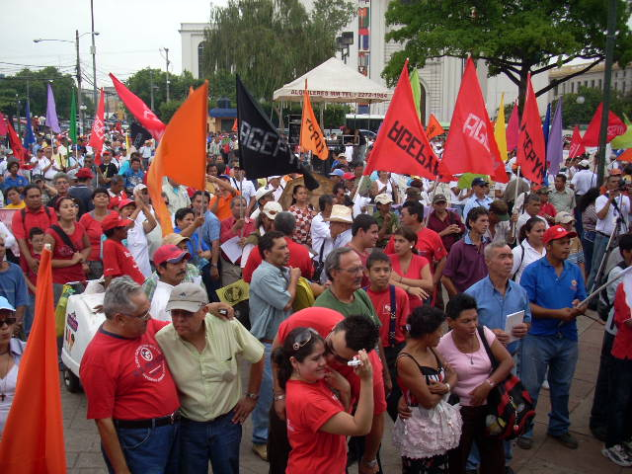

Slide 12
Evangelism
Training of pastoral leadership
Mentoring and counseling of pastors
Monday sermon/reflection for all pastors
Strengthening parishes
Strengthening our ecumenical movement

Slide 13
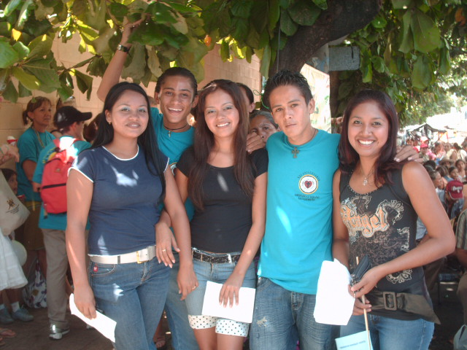

Slide 14
Family Ministry
Forming community youth leadership
Developing good values in the children and youth
Hold Sunday School for the children and youth
Develop and encourage participation in the women’s leadership group

Slide 15
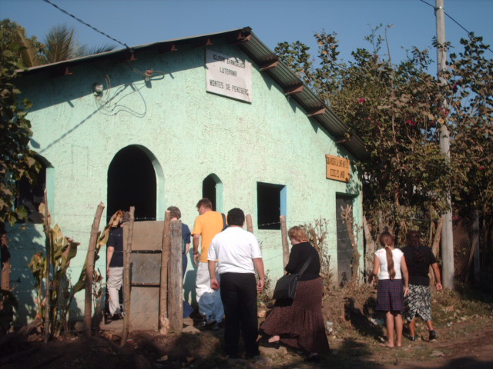
Risk management and managing life
Strengthening the capacity of communities in the areas of disaster prvention and responding to emergencies.
Strengthening ecumenical networks: pastors, ACT and communities.
Supporting the construction of knowledge: what does theological knowledge tell us about risk management.

Slide 16
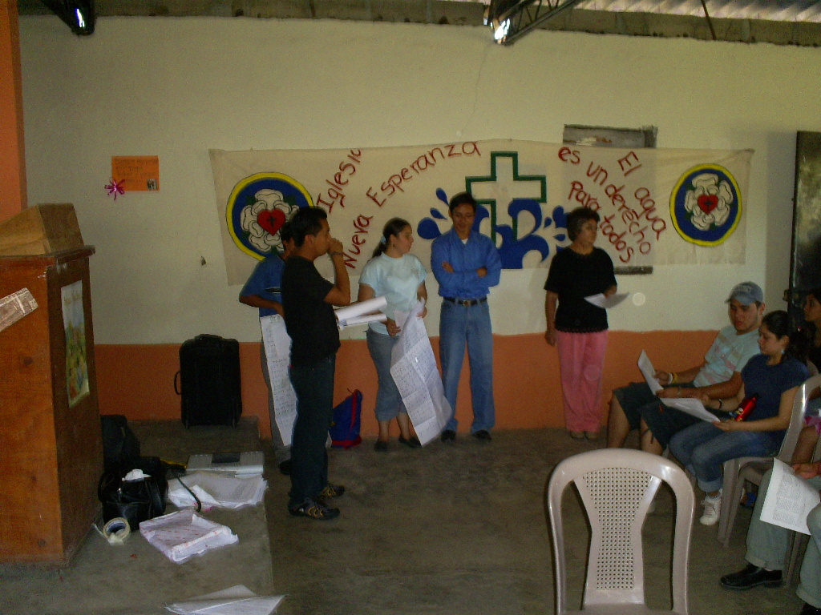

Slide 17
Accompanying those with HIV -AIDS
Working with and feeling a part of the social workers who work with persons who are HIV positive.
Working as mediators on reconciliation between groups in civil society.
Promoting prevention at the community level.
Working against stigmas and discrimination.

Slide 18
Fight against hunger and poverty
Small projects that provide training and generate income
School scholarships for boys and girls from impoverished communities
Work with medical delegations to attend to the health of communities
Food security projects

Slide 19
Walking with the poor and homeless in San Salvador
Project - Casa de la Esperanza:
One hot meal daily
An opportunity to bathe
An opportunity for conversation without violence
An opportunity to be listened to
An opportunity for rehabilitation

Slide 20
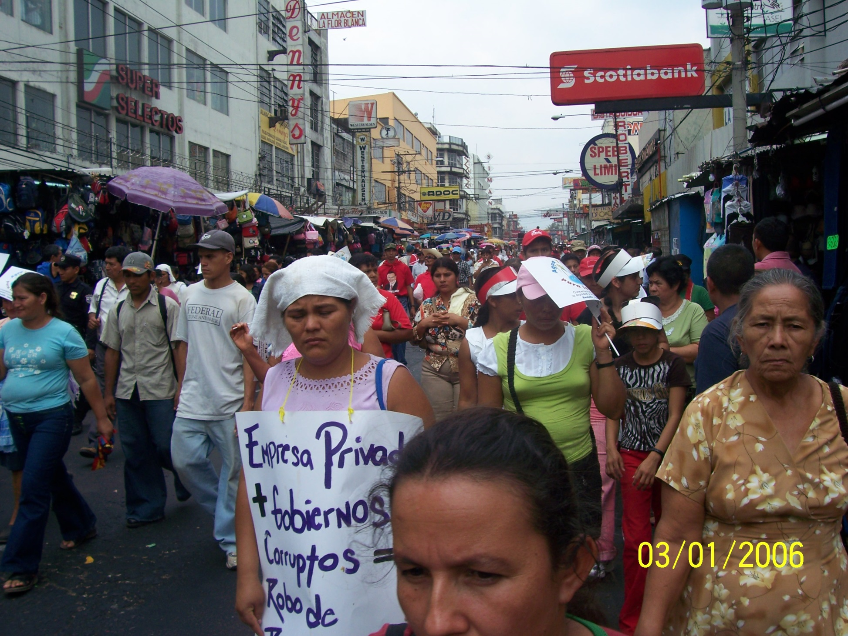

Slide 21
Our Horizon
A church that accompanies its people with a prophetic and transformative practice done with new approaches, appropriate for the conext.
A strengthened, transparent and sustainable faith in action
A civil society responding strategically to the challenges and needs of the poor so they may life in abundance in this country

